Slide 1
Microservices and DevOps
Scalable Microservices
Versioning
Henrik Bærbak Christensen
Notes:
Nygard §14

Slide 2
Motivation
Microservices = independently deployable services, collaborating to form a whole system.
However, as we make changes to add features, we need to be careful not to break consuming applications [Nygard, p 263]
  Do not force consumers to match your release schedule
Postel’s robustness principle
  Be conservative in what you do, be liberal in what you accept from others.

Slide 3
‘Own’ Versions
Those that we ourselves control
‘Inter-organization services’

Slide 4
Non-breaking Changes
Non-breaking = obey all agreements on all levels of the stack (http, tcp, ip, ….)
Request-reply is asymmetric wrt. ‘robustness’
  Can accept more but never less, and never require more (Req)
  Can return more, but never return less (Reply)
Nygard reflection
  Is the specification the documented one or the implemented one?
  Nygard’s standpoint: it is the implemented one
    Which must keep obeying the robustness principle

Slide 5
Testing Concerns
Nygard advocate random generative testing against your service, to find ‘gaps’ between spec and implementation
  Resemble his ‘test harness’ pattern to generate ‘out-of-spec’ tests
Alas
  Randomized tests that do weird thing given the structure of the API
    Forget keys in JSON post, send null values, empty arrays, etc.
Ex
  I found a bug in my ‘CaveService’ as I POST’ed a room with user id as key ‘id’ instead of ‘creatorId’. The service just made a room without a creator ☹
Notes:
Disclaimer – I have never used tools to do random generative testing. And my concern is – it is random that I hit a bug!

Slide 6
Breaking Changes
A Breaking Change is necessary. What to do?
Principle 1:
  Use version numbers on the message format
    Not an application version, but a format version
    The ‘format indicator’ pattern in Messaging (Hohpe & Woolf, 2004)
  Helps in debugging and detection

Slide 7
Breaking Changes: REST
Http REST service: Changes in the API structure ?
Proposals
  Put version in URL: /v1/xya
  Use ‘Accept’ header and ‘Content-Type’ header
  Intro a ‘api-version’ custom header
  Intro a version key in the request body
All are bad, but least pain is first proposal
Principle 2:
  Version the API by adding version id in the URL
    Easy to understand by developers
    No fiddling with load-balancers, caches, proxies, etc.

Slide 8

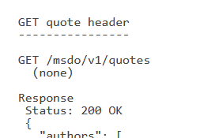
SkyCave Examples
From our own backyard
Btw: Did you do it in the REST services ☺?

Slide 9
Breaking Changes
Principle 3:
  Both old and new version must be supported ‘for some time’
    That is, side-by-side operation
    Test heavily with a mix of versions
      CREATE with new API and READ with old often poses problems
  All new paths must be available at the same time
    It is a no-no to have half of the features migrated to /v2 but forcing clients to access the other half using /v1 !!!

Slide 10
Breaking Changes
Principle 4
  Use a (1 version deep) translation pipeline for the old version code
That is
  /v2 controller code forward directly to business logic layer
  /v1 controller code convert incoming to new format, call business logic, convert result back to v1 format and return…
Notes:
Translation pipeline is defined in §13 of Nygard

Slide 11
‘Others’ Versions
Intra-organization versioning

Slide 12
If ‘Others’ Do Not Behave Well
Growth scenario
  Your API adds three new fields to a query
Reflection
  All combinations of weird/missing assignments to these new fields are to be expected!
Principle 5
  Your software should remain cynical! Protect your service, apply the stability patterns to each and every integration point.

Slide 13
The Testing Aspect

Slide 14
Testing Aspect
The ‘call-external-service’ algorithm is basically
  Convert domain object(s) to REST payload
  Do the external service call
  Receive the returned payload
  Convert payload to domain object(s) and process
That is
  Translation, processing, translation
  The version issue revolves around the translations!

Slide 15
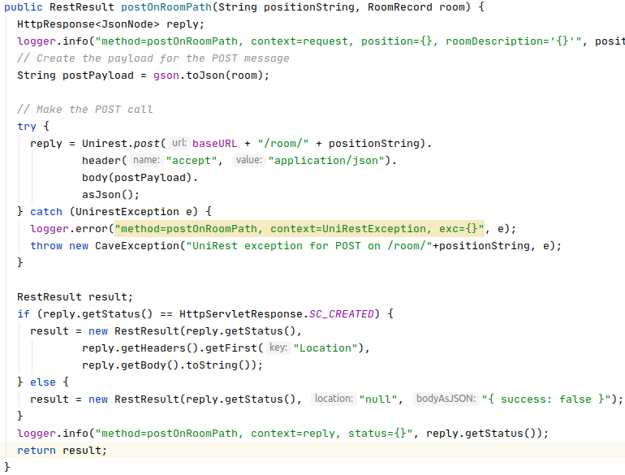
Example: My CaveService Connector
Translating the
room record (domain
object) to JSON
Call the service
Translate reply
to domain object
(Hm, hm, so so…)

Slide 16
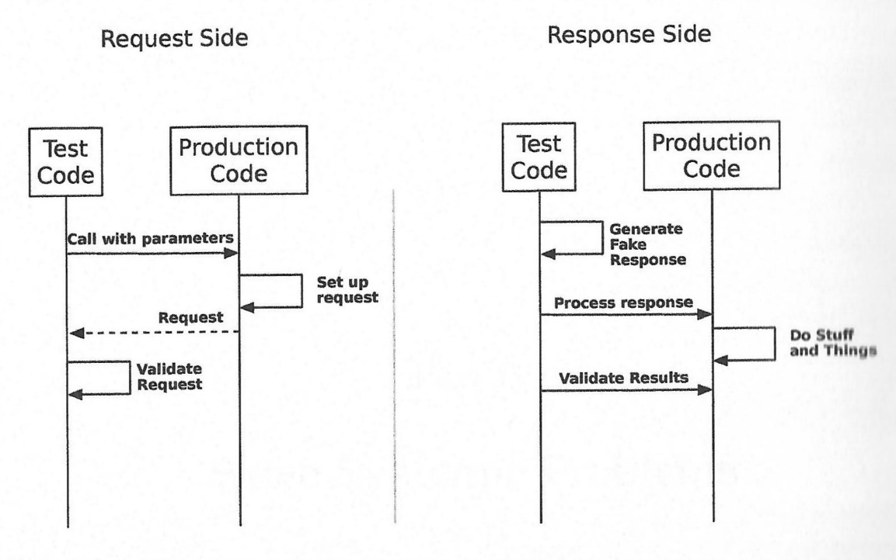
Testing Aspect
Nygard recommend separate testing of the two translations to prepare for out-of-spec issues…

Slide 17
Testing Aspects
The request translation side is as-far-as-I-can-see just normal contract testing
  Just checks that
  requests are
  created according
  to provider’s
  requirement

Slide 18
Testing Aspects
The reply translation side is more interesting IMO
  Inject ‘weird’ responses
  and validate
  proper handling
Do not require
actual remote calls

Slide 19
Requirements
Have to further
refactor my code
to support proposed
tests
Each ‘box’ must
be individually test
units …

Slide 20
Summary
Postel’s principle is easy to state…
But require quite a lot of coding efforts and testing…
Design for failure…

